Slide 1
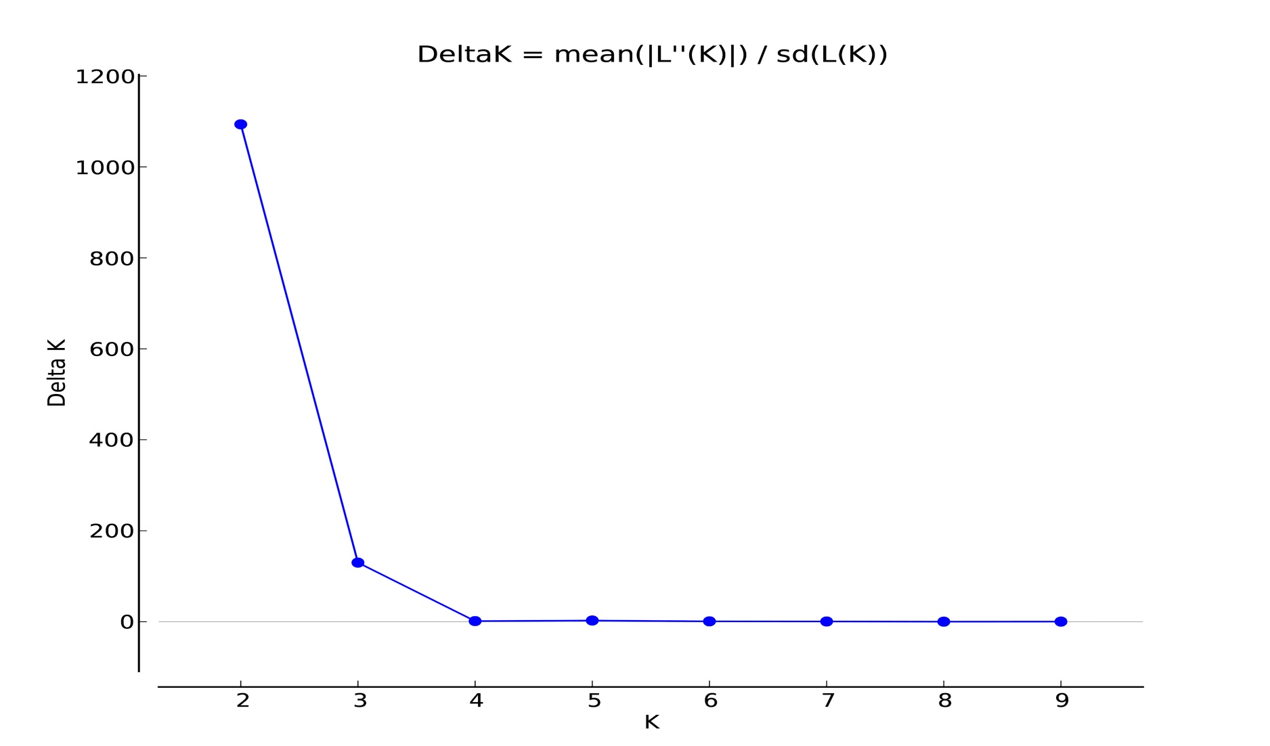
S2 Fig. Estimation of the optimal number of populations (K) using the deltaK/K method.

